Slide 1
CLEANING DATA WITH OPEN REFINE
DATA STORYTELLING

Slide 2

What is Open Refine?
A web application that runs locally on your computer
Don’t need an Internet connection to clean your data in Refine
Can read numerous different formats of data
Also allows for exploration of data – not just cleaning
Good practice: http://onlinejournalismblog.com/tag/google-refine/

Slide 3
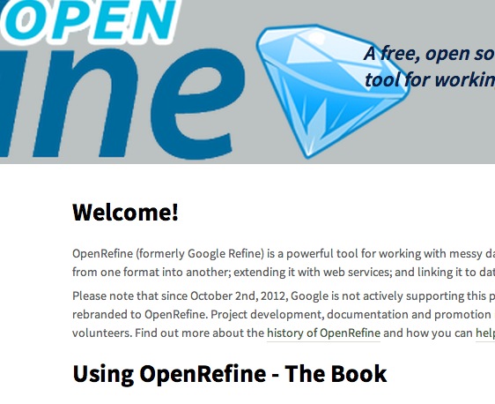
Today’s Lesson
Cleaning data with:
Cell splitting
Text facets
Clustering
Merging cells

Slide 4
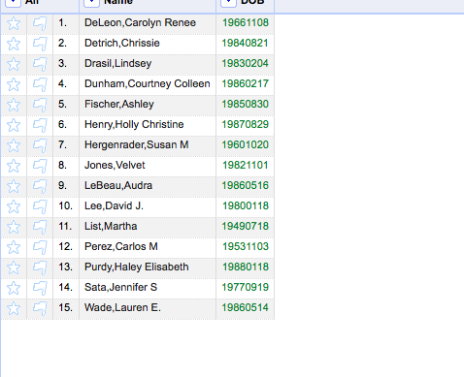
Let’s import some data to clean
Download the spreadsheet called “Employees” from Blackboard
Save it to your desktop
Start Open Refine
Import the spreadsheet
Create a new project named Employees
Do a four corners test: what do we have in our data?

Slide 5
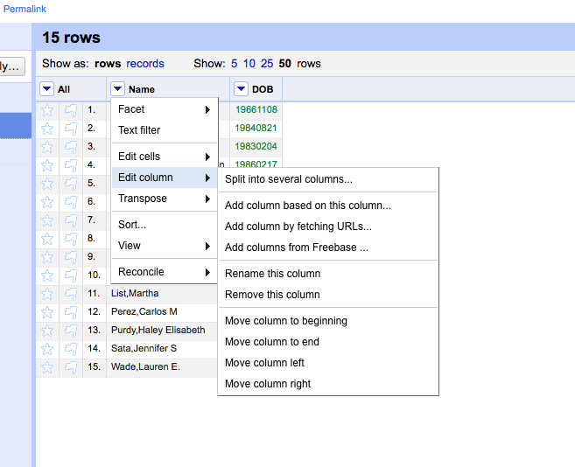
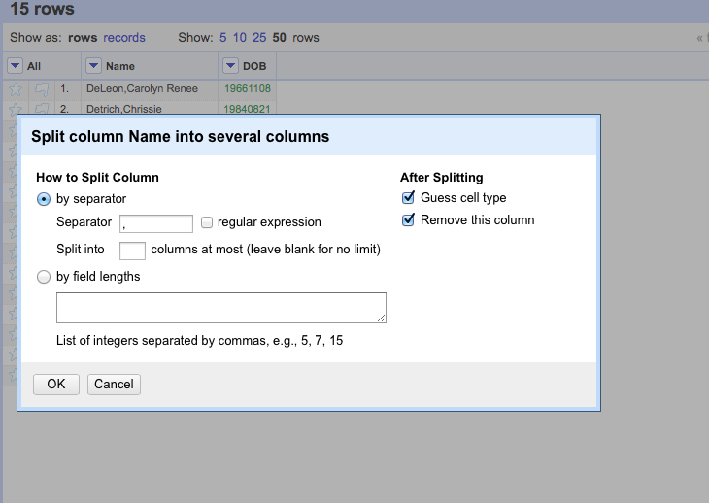
Cleaning by splitting cells
We have our first and last names merged together, which can make it difficult to sort
Let’s split the cell into two columns
Click on the down arrow in your NAME column
Go to edit column
Go to split into several columns
We need to tell Open Refine how our data is separated in the column, which is a comma
And how many columns we want it broken into, which is 2

Slide 6
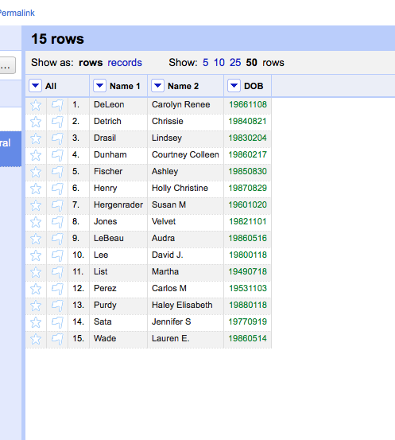
Cleaning by splitting cells
Insert a 2 into our column field
Let’s insert a comma into our separator field
Click ok
Your cell is split into two columns –
Last name and first name

Slide 7
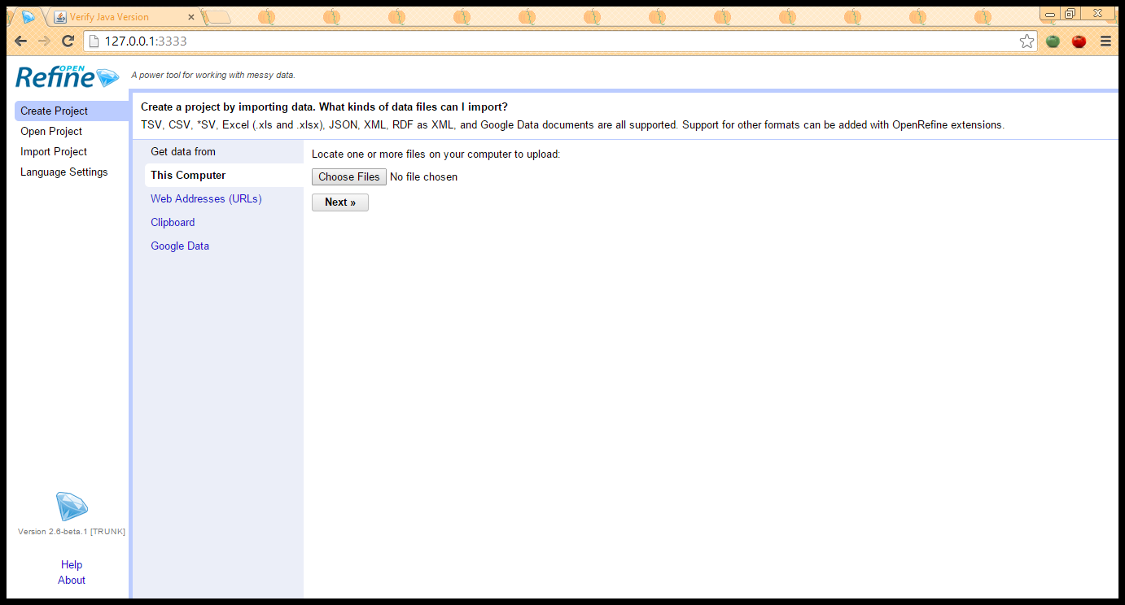
Let’s import some data to clean:
Go to the Massachusetts state Office of Campaign and Political Finance
Download into Excel all contributions for Boston Mayor Martin J. Walsh
Upload the data to Open Refine
Create a new project

Slide 8
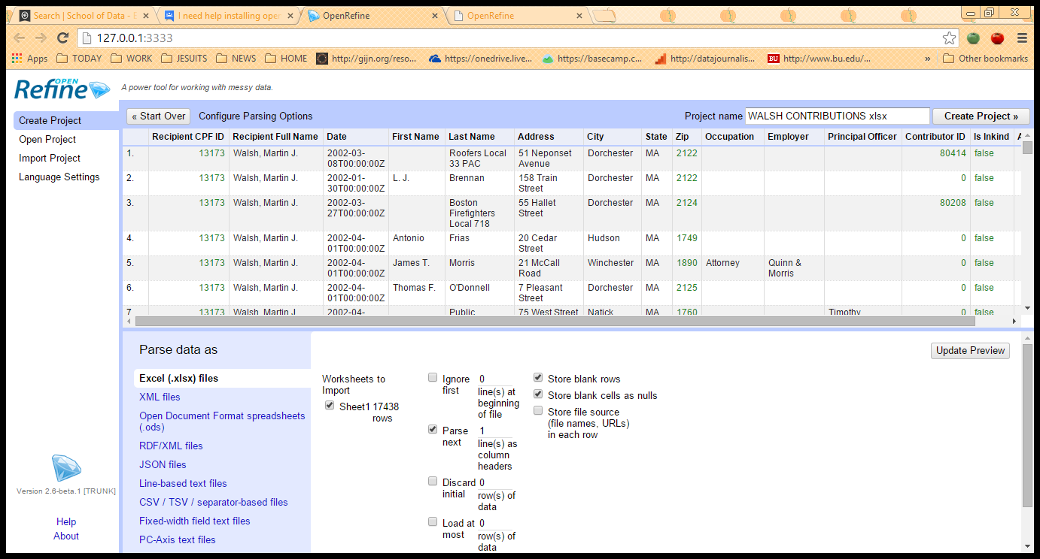
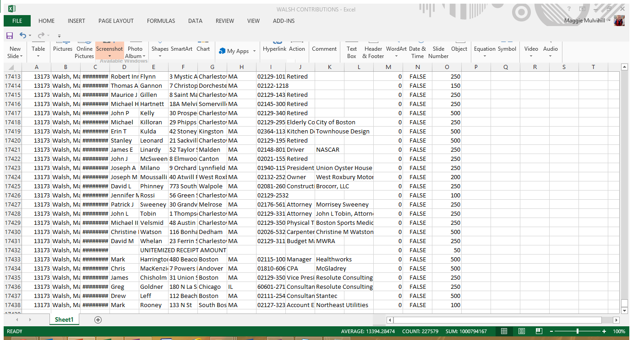
Doing your four corners tests:

Slide 9
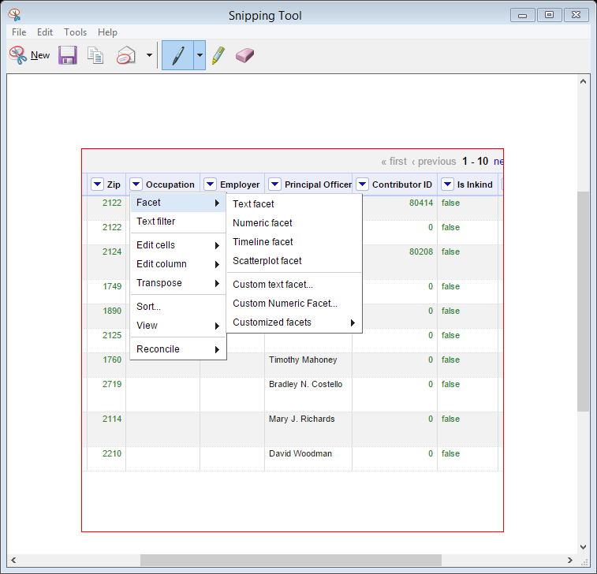
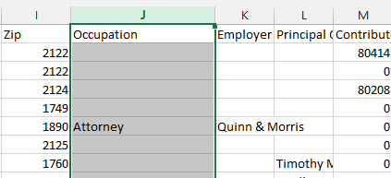
Cleaning columns with text facets
Let’s start with the “Occupation” Column – Column J
Pull down the right arrow on the column
Choose text filter
Choose text facet

Slide 10
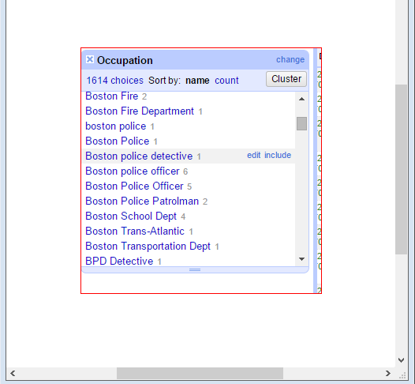
Cleaning with text facets
We get a wide array of the same occupation named differently i.e. Boston Police employees
Let’s clean these up:
We see we have 1614 different rows of occupations though many are the same agency or employer
Let’s first get rid of any trailing white spaces
In Column J go to edit cells – common transforms – trim white space
You’ll see: Then Text transform on 9 cells in column Occupation: value.trim()Undo

Slide 11
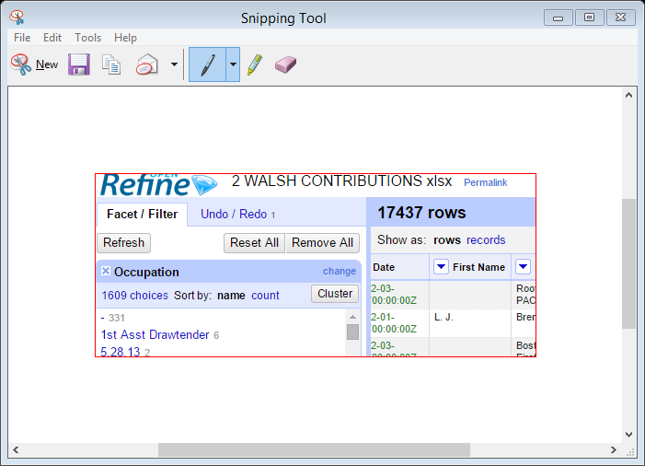
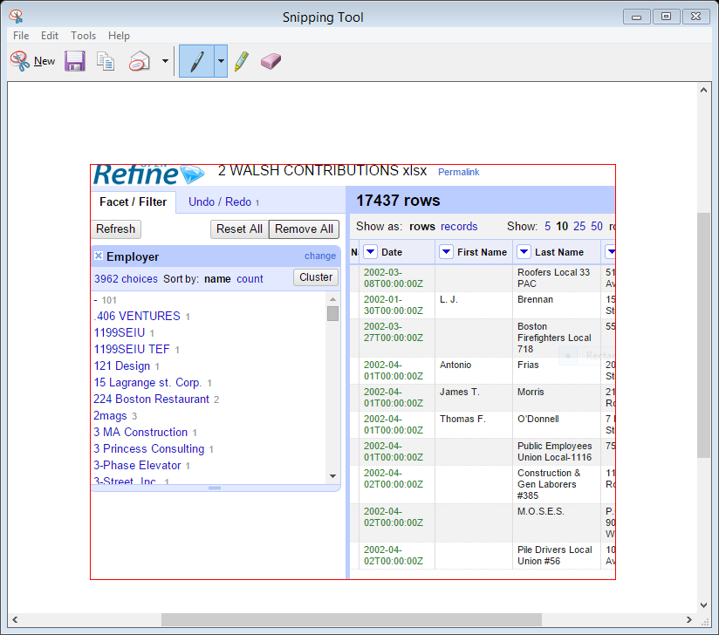
Cleaning with text facets
Before we go further with cleaning the occupation column for police, let’s check the employer column – Column K
Remove the data we were cleaning – occupation - by clicking Remove All
Now click on:
Employer – Column K
Facet
Text Facet
You should get 3962 employers

Slide 12
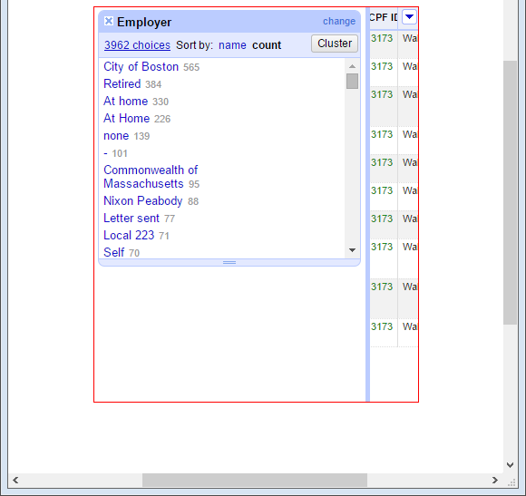
Cleaning by clustering
Let’s count our employers in descending order
Click:
Count
We see City of Boston at the top with 565 employees giving to Walsh
Is that accurate?
No, because the City of Boston and other EMPLOYERS are listed in this column many different ways
Let’s clean by clustering

Slide 13
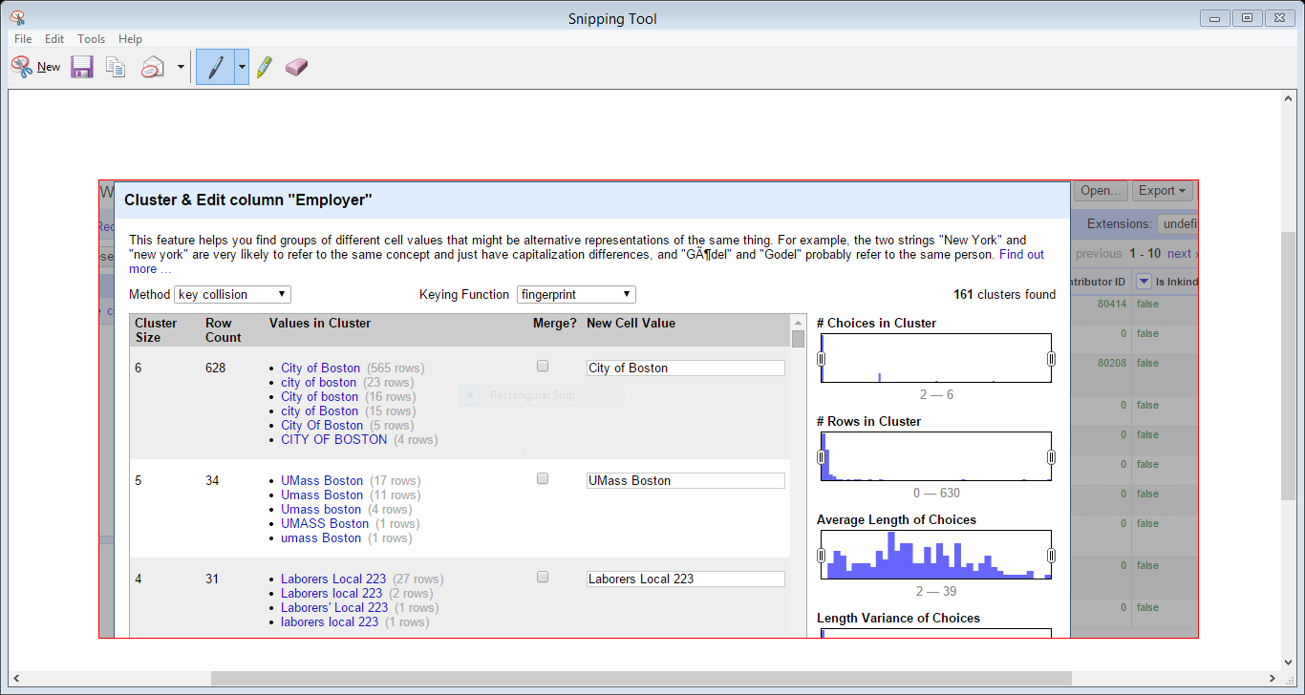
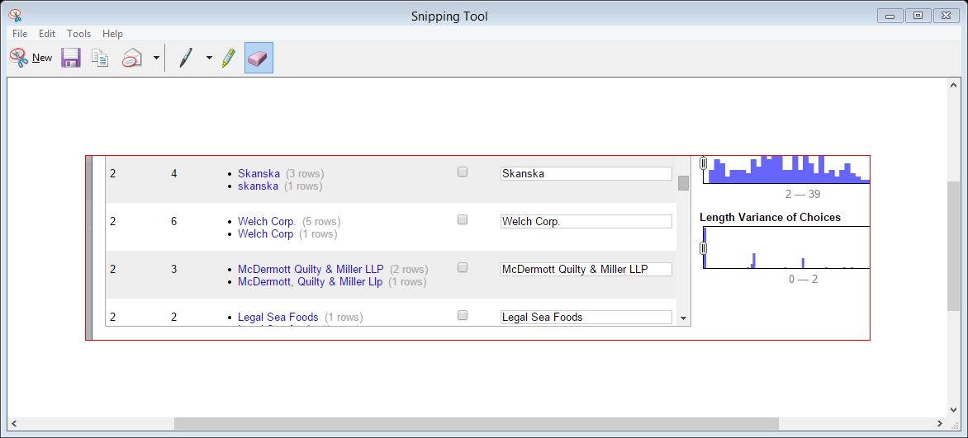
Let’s cluster by employer
Click on:
Cluster
We get a grid that gives us choices in how we want to name EMPLOYER
There a lot of problems with this column
Commonwealth of Mass is listed a number of different ways
so is self and unemployed (also listed as not employed)
So is McDermott Quilty & Miller LLP, which is also listed as McDermott, Quilty and Miller
So is MBTA

Slide 14
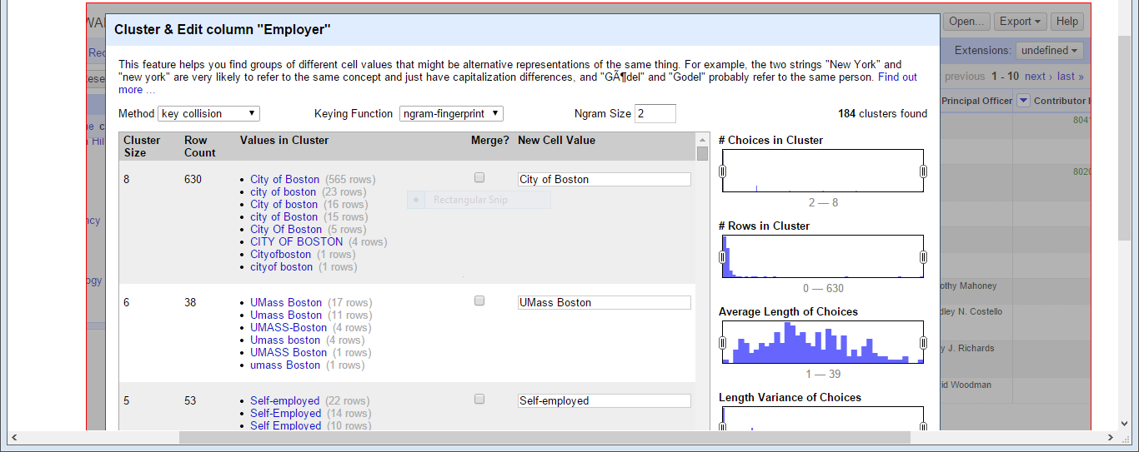
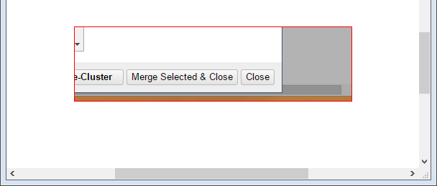
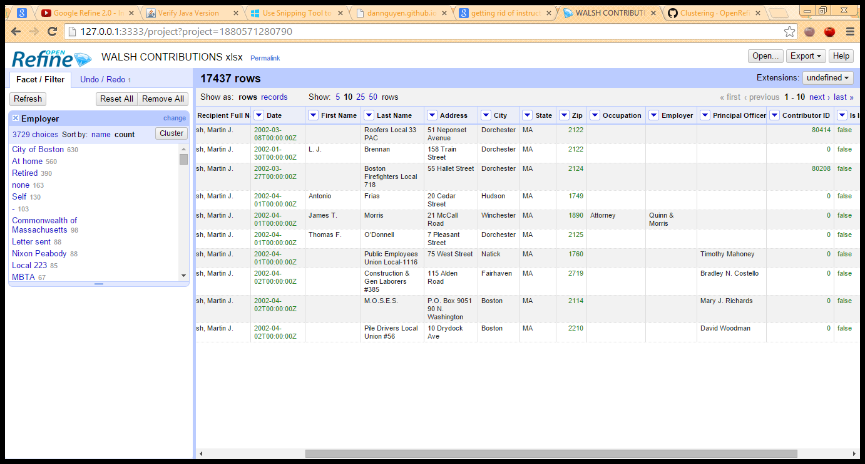
Cleaning with clusters
Clustering helps you find groups of different cell values that might be alternative representations of the same thing
If we keep “fingerprint” we get 161 different clusters; if we choose “ngram-fingerprint” we get a more aggressive look with 184
You can select each group whose choices you want to "merge" and enter the text that all choices in that group will be replaced with
Or you can select all and merge selected and close to match all similar EMPLOYERS together
That cleans the data up to give you 3729 different EMPLOYERS

Slide 15
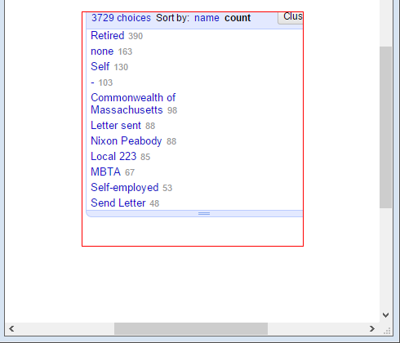
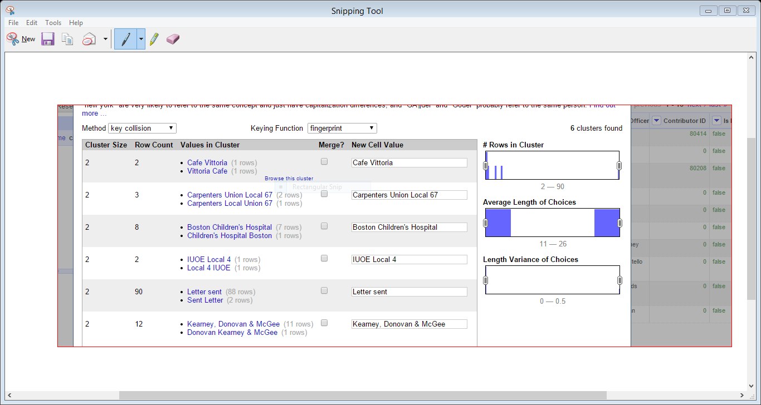
Cleaning with clusters
Let’s check our EMPLOYERS – any problems?
there are 6 additional clusters with differing names
If we click select all and merge selected and close, we’ve cleaned our data again and brought the group down to 3723
Any problems?
If we choose fingerprint or ngram-fingerprint, we don’t see any additional clustering
Let’s try another Keying Function – Metaphone 3

Slide 16
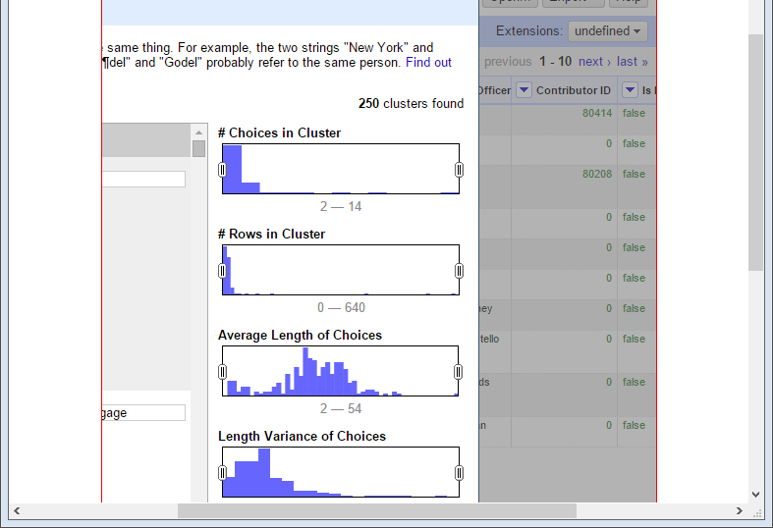
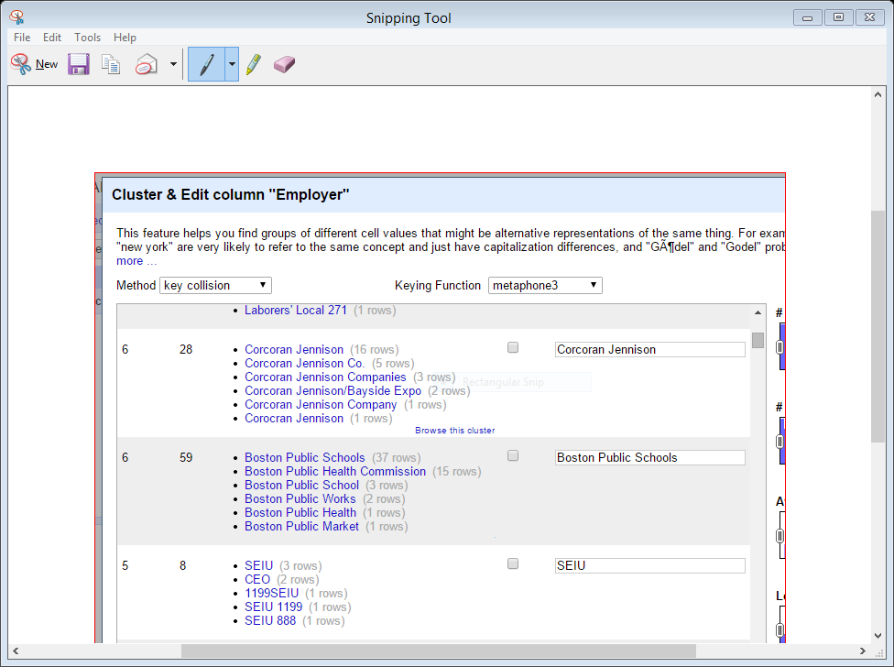
Cleaning with clusters
Now we see 250 groups of names clustered together
What’s the problem?
Open Refine has been too aggressive in clustering; some of these EMPLOYER names don’t belong together i.e.
Boston Public Schools
Boston Public Works

Slide 17
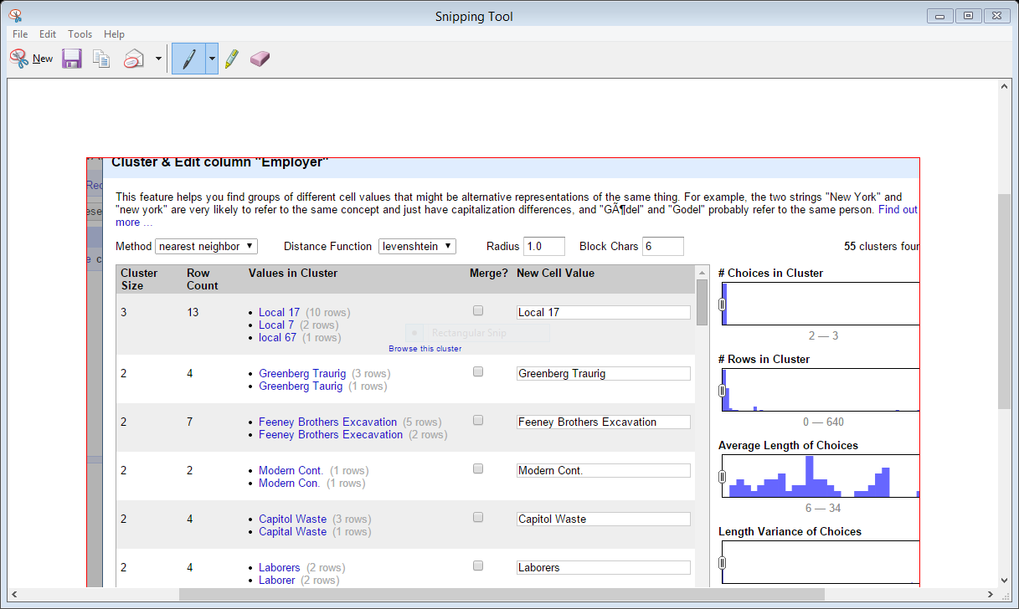
Cleaning with clusters
What if we changed the method from key collision to nearest neighbor?
That gives us 55 clusters
Let’s check our EMPLOYER names; if ok click select all and merge selected and close
That brings us to 3671; let’s continue
Change method from key collision to nearest neighbor
We should get 2 more clusters
Click select all and merge selected and close

Slide 18
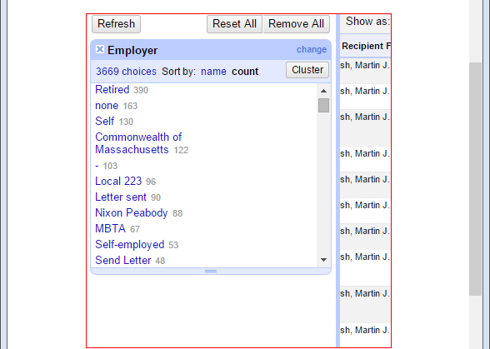
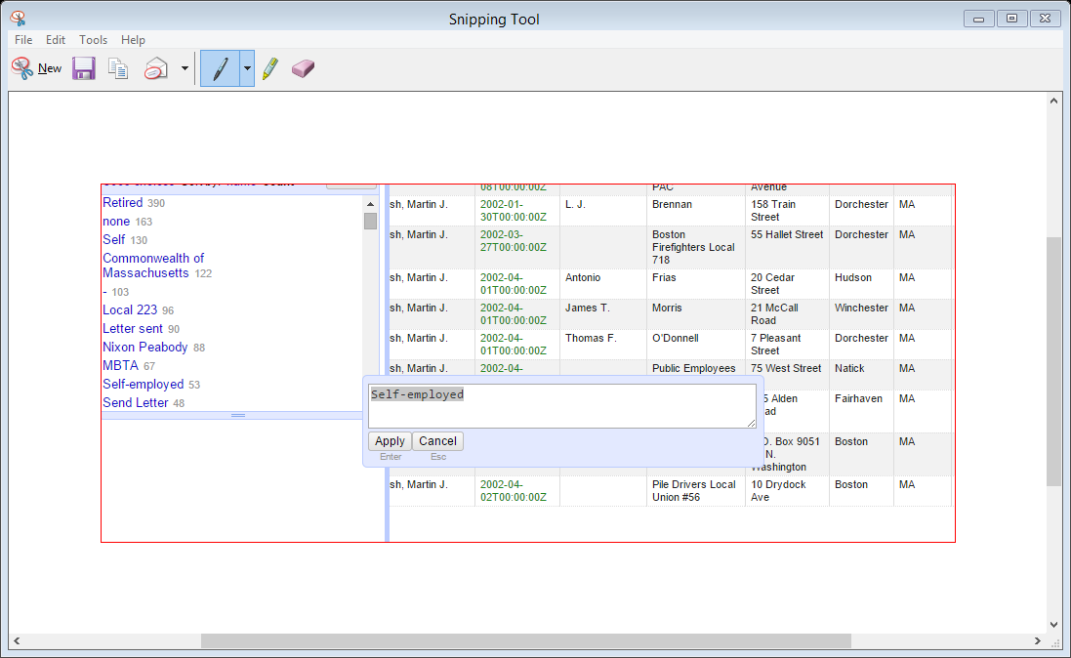
Cleaning with clusters
Now are down to 3669
Rather than continue to cluster and recluster this way, let’s edit the EMPLOYER names
We have one group called self and one called self-employed; let’s edit self-employed to just say self
Let’s do the same with letter sent and send letter
And with Boston Police Department
And so on
IMPORTANT – if you aren’t sure to merge something DON’T

